Slide 1

Regional Planning Initiative
Southeast Alaska Regional Solid Waste Strategy
Findings and Recommendations
|
Southeast Conference Annual Meeting 2026
L0007.25001

Slide 2
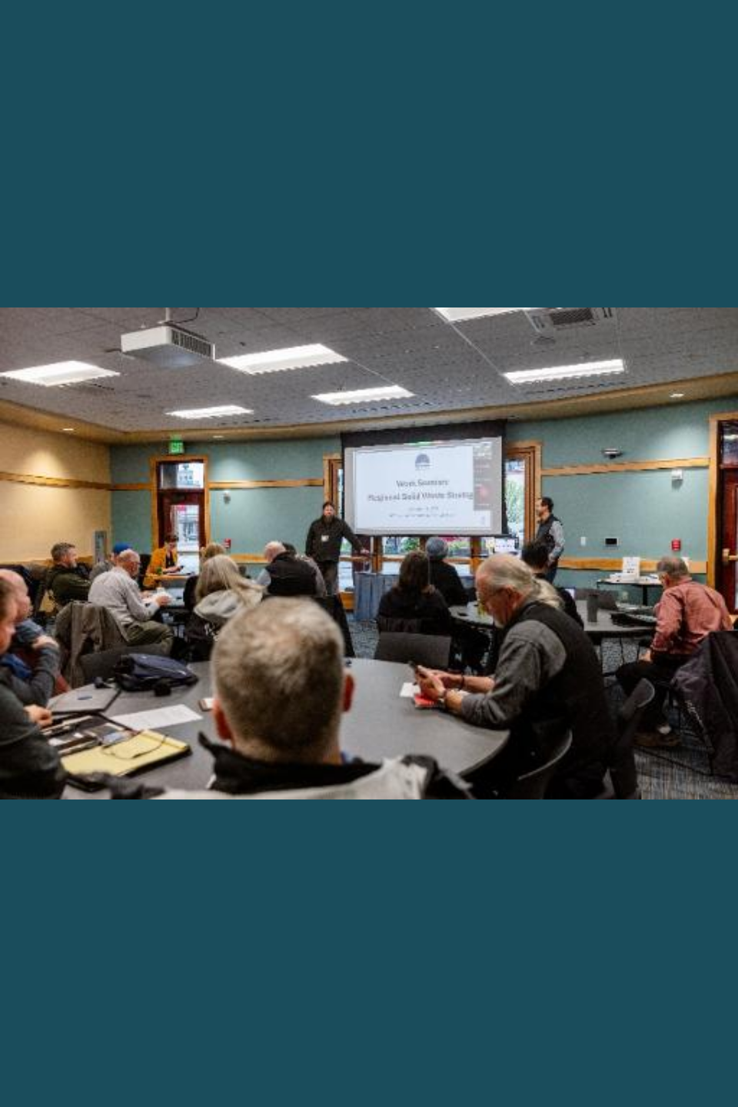
What This Project Is — and Why It Matters
Rising disposal costs and fragmented waste management are straining communities across Southeast Alaska — this study was designed to find a better path forward.
Southeast Conference (SEC) contracted RESPEC in 2025 to conduct a regional municipal solid waste management study covering 35 communities across the panhandle
The study aims to reduce costs, consolidate facilities where feasible, and protect the environment
SEC partners with SEASWA — a public authority formed to support cost-effective and environmentally sound waste management — to implement the strategy
The region faces a common challenge: small, remote communities managing waste largely on their own, with limited resources and limited data

Slide 3
How We Did the Work
The study combined community-by-community outreach, data collection, research, and collaborative workshops to build a picture of waste management across Southeast Alaska.
Current Stage
1
2
3
4
5
Task 1
Task 2
Task 3
Task 4
Task 5
Community Waste Profiles
Community Engagement
Solution Evaluation
Regional Strategy
Implementation Planning
Research on education, equipment and infrastructure, policy, and emerging technology options
Findings and recommendations compiled in this document
Volume, composition, and cost data collected for each of 35 communities through interviews, plans, and inspection reports
One-on-one interviews with communities, industry stakeholders, and elected officials; SWOT workshop at 2025 SEC Annual Meeting
The current stage, now underway
Supporting Documents: Community profiles, a regional profile, a regulatory framework memo, emerging technology memo, Canada maritime provinces memo, and a policy and procedure recommendations memo

Slide 4
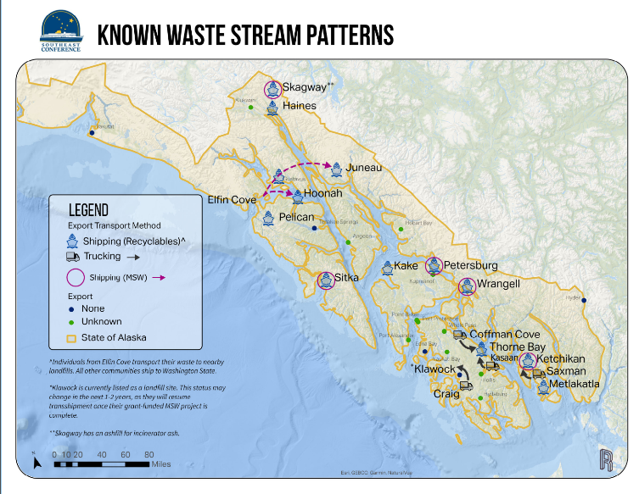
Who We Talked To and What We Found About the Region
Southeast Alaska's 35 communities span a vast geography — their waste management situations are as varied as the landscape itself.
Outreach covered incorporated and unincorporated communities, Tribes and Tribal organizations, nonprofits, service providers, and agency representatives
18 communities have landfills that accept some forms of waste; communities without a landfill must export waste that cannot be diverted through composting or reuse
The region includes one Class I landfill (Juneau), 16 Class III landfills, and one EPA-regulated landfill (Metlakatla Indian Community) — each with different capacity and regulatory requirements
Most MSW and recycling shipped out of the region goes to Seattle
Water-based transportation is the primary method for exporting waste — barge access varies significantly across communities
Waste stream patterns in Southeast Alaska

Slide 5
Finding 1
Data Are Limited, and Costs Are Highly Variable
Illustrative Planning Costs per Ton (FY2026)
Without consistent data, it is hard to plan effectively — and what data we do have shows cost differences that are dramatic from community to community.
Waste volume data collected through interviews and inspection reports; EPA per capita averages used as estimates where unavailable
Fuel-driven fluctuations in shipping costs create budget shocks — especially for small communities relying on barge
High cost variability makes it difficult to compare communities or evaluate regional solutions without better data
KEY GAP: Most communities do not systematically track waste type or volume — a standardized tracking system is a top near-term priority

Slide 6
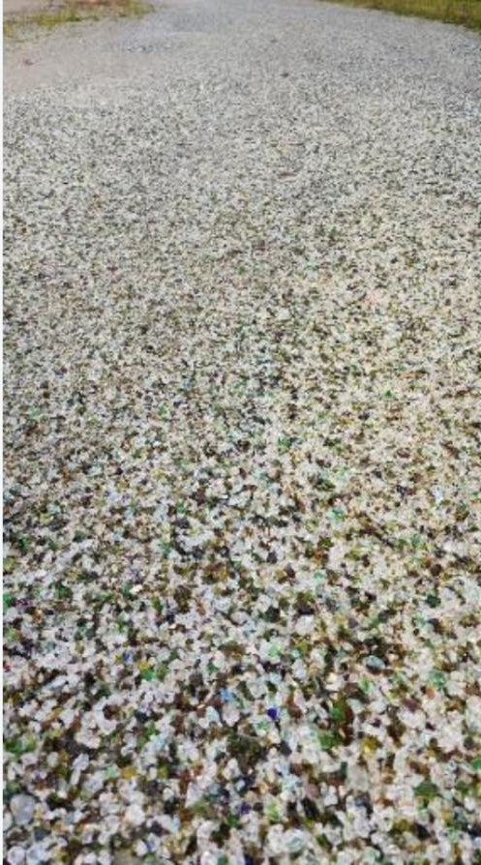
Finding 2
A Variety of Approaches, with Bright Spots of Innovation
Communities are not standing still — many are finding creative, local solutions, and those examples show what is possible for the region.
Each community has its own mix of waste management programs — there is no single regional approach
Gustavus DRC: diverted 55% of waste from landfill in FY2025 — accepts food waste for composting and operates the Community Chest thrift store
Gustavus also uses crushed glass as landfill cover and road aggregate — reducing landfill volume and shipping costs
Haines Friends of Recycling (HFR): developing a new material recovery facility (MRF) to produce Grizzly Wood — a value-added recycled product
Skagway operates a transfer station with an incinerator; Petersburg recently installed a new baler facility
Backhaul programs — using return shipping trips at reduced cost — are already removing scrap metal and hazardous waste in some communities
Crushed glass on the Gustavus DRC access road — an example of in-region material reuse

Slide 7
Finding 3
SEASWA Has Room to Grow
SEASWA exists to serve as the region's cooperative engine for waste management — but it is currently operating well below its potential.
Mission
Provide environmentally sound and cost-effective management of solid waste to protect public health, improve the environment, and recover resources.
Current Members (2026)
Current Role — Underutilized
Potential Role — Strategic Engine
Hydaburg
Information sharing among member communities
More members — expand to additional communities across the region
Wrangell
Petersburg
Shared tire shear — coordinating use of one piece of equipment
More programs — regional backhaul routes, joint equipment purchasing, shared training
Thorne Bay
Craig
Legal authority under AS 29.35.800 to enter contracts, purchase equipment, and facilitate regional programs — largely untapped
More regional coordination — contracts, grant-seeking, and advocacy on behalf of all communities
Klawock
Kasaan
SEASWA is the responsible party for the majority of near-term high-priority actions — strengthening the organization is central to the entire strategy
Coffman Cove
Tenakee Springs
Open to all municipalities, Yakutat to Ketchikan
Southeast Alaska Regional Solid Waste Strategy | Project L0007.25001
7

Slide 8
Recommendations — A Toolbox for the Region
The strategy provides a phased set of practical, community-scale recommendations — organized by who does what, at what scale, and when.
Near-Term
Mid-Term
Long-Term
2026–2030
2031–2040
2041 and beyond
High-Priority Actions
Building on Near-Term Progress
Aspirational & Grounded
Standardize waste tracking across communities
Develop a Prince of Wales Island material recovery facility (MRF)
Build one or more waste-to-energy facilities as regional cooperation and technology mature
Establish regional scrap metal & hazardous waste backhaul routes
Establish joint contracts for regional waste services
Develop regional or subregional landfills where appropriate
Coordinate regional glass pulverization
Site potential waste-to-energy or regional landfill facilities
Expand landfill best practice training & composting programs
Establish a facility for processing tires into tire-derived aggregate
Strengthen wildlife management protocols
Build SEASWA's operational capacity — more members, more programs
Recommendations are organized at three scales — Community, Subregional, and Regional — so each audience knows where they fit. SEASWA is a lead responsible party or facilitator for the majority of near-term actions.
Notes:
Near-term: get SEASWA house in order and have communities focus on reducing their waste stream

Slide 9
How We Will Know It's Working — Performance Measures
Progress can only be tracked if we measure it — the strategy establishes clear indicators at both the local and regional level.
Local Measures
Regional Measures
Tracked by each community
Tracked by SEASWA / SEC
Waste generated per capita
Communities submitting annual data
Waste diversion rate
Communities participating in SEASWA programs
Cost per ton of waste managed
Shared equipment deployment days
Household hazardous waste collected
Regional waste management cost per ton
Staff trained in solid waste management
External grant funding secured
Compliance violations
Better data tracking is both a near-term recommendation AND a prerequisite for measuring progress on all other recommendations — data requested from each community at least annually.

Slide 10
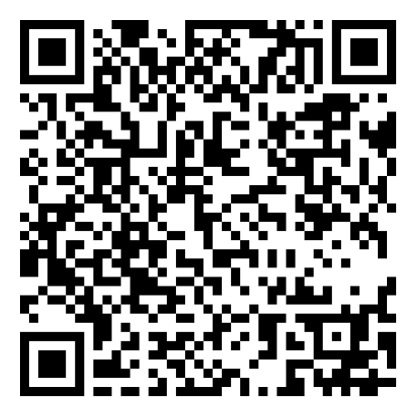
Next Steps
The strategy is drafted — now is the time to review and comment.
Comments are due by October 30, 2026
SEASWA
Communities
SEC & SEASWA
Adopt policy and procedure recommendations
Develop a centralized waste data tracker
Establish regional backhaul routes for scrap metal and household hazardous waste
Coordinate multi-community landfill training
Begin tracking waste volumes and types
Assess individual backhaul needs
Designate reuse areas at landfills or transfer stations
Send staff and elected officials to waste management training
Share strategy findings with legislators and agency decision-makers
Advocate for Congressionally Directed Spending and state grants for waste infrastructure
Use the Solid Waste Savings Model to evaluate the financial case for diversion programs
RESPEC can help individual communities implement recommendations
Southeast Conference | RESPEC | September 2026

Slide 11
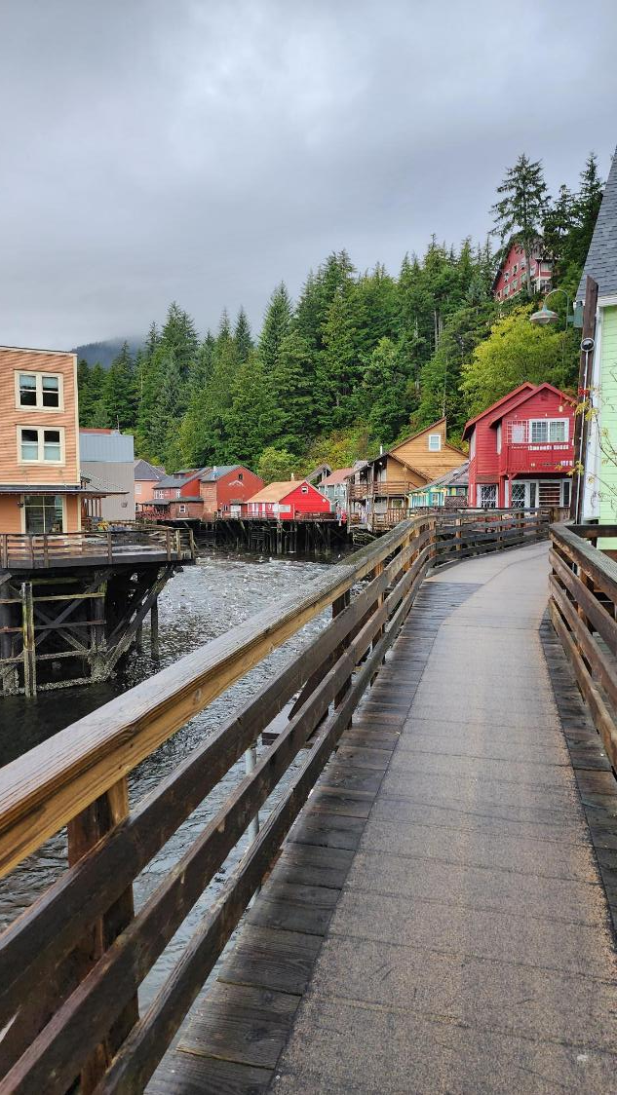
Questions?
Patrick Cotter
pat.cotter@respec.com
Megan Flory
megan.flory@respec.com

